Slide 2
Before Starting
Thank You for Volunteering for the IT Open Days’ Activities!
More than 110 people have volunteered to cover the 2 days!
You should have received notification from the Core Team on your role and time slot allocation. This may be different from what I have communicated, which should take precedence.
  However, there have been some enforced changes to the role and time slot allocations and a new version will be sent out soon.
These slides are available on the IT Open Days site: https://it-opendays.web.cern.ch/system/files/2019-08/IT_Open_Days_Information_for_Volunteers_July_2019.pdf

Slide 3
IT Activities - I
Data Centre Visits – a circuit through the two main computer rooms following a general presentation
  Starting at 9:00
  6 groups every 15 minutes with two guides each (ideally one English and one French speaking)
  A presentation before the visit will be in English and French (see later slide)
  Info sheets will be available in other languages
  Slogan – “The CERN Data Centre where data becomes knowledge”
R2 Activities for Children Around IT and Programming
  Starting at 11:00
  Unplugged Programming – introduction to programming ideas without computers
  Programming Robots – introduction to programming ideas using robots
  LHC@Home – information on, and demonstration of, volunteer computing
  IT Specific Colouring Book – a fun activity for younger children
  Virtual reality goggles – a virtual visit of the Data Centre for everyone
  Special balloons will be available

Slide 4
IT Activities - II
Data Centre Visit Point – an animation of the data production, distribution and processing from detector to WLCG (French and English speaking groups)
  Starting at 9:00
  1 group every 15/30 minutes with two guides
  Will see the Data Deluge animation showing the data production in the detector through to processing in the WLCG
Web film in IT Amphitheatre – celebrating 30 years of WWW (lasts about 35 minutes)
  Starting at 11:00
  Film is in English with French subtitles
  Showing once an hour on the hour and lasts about 35 minutes
Short IT-related Talks in 513/1-024 – a series of general IT talks aimed at the general public (a schedule will be provided and displayed)
  Starting at 11:15
  Slides will be in English or French with the speaker presenting in the other language
  10 mins + 5 mins questions
  2 talks per hour (15 past and 15 before the hour)

Slide 5
Main Information - I
There have been misunderstanding in the visitor registration and hence some are likely to be unhappy:
  Remain calm and friendly
Information for visitors wanting to know more about IT will be available via: cern.ch/go/opendays
Key Data Centre numbers for guides: https://information-technology.web.cern.ch/sites/information-technology.web.cern.ch/files/CERNDataCentre_KeyInformation_August2019V1.pdf
Guides must remain with their groups at all times and keep them together (one in front and one behind) and respect the timing of the visit
  Specific on-site training will be provided for the guides for the Data Centre & DCVP
People with reduced mobility will be taken separately with a dedicated guide and they will only visit the ground floor computing room

Slide 6
Main Information - II
Information on queue waiting times at the various sites will be available via Alex’s Mobile App
We cannot take responsibility for children, i.e. an adult must remain with children at all times
The lifts should not be used
Toilets in the IT buildings should not be used by Visitors, and Visitors should not divert from designated routes
  Toilets available in R2 and IT car park (not yet shown in GIS Portal!!)
Be aware of the restrictions on access to the site, other than on foot Information is available via the Volunteers’ registration site
The B28 Social Room can be used during off periods to relax
Guides for the Data Centre visits must wear closed shoes and no high heels are allowed.

Slide 7
General Training
The Core Team will organise training courses for all volunteers based on their specific roles. You can see which courses are required via you registration. There is a general course for all volunteers:
  4th (10:00), 6th (14:00) and 11th (15:30) September in the main Auditorium in English
  9th (9:00-11:00) September in French
  Please enrol for the date which suits you best
All volunteers are required to have completed the three mandatory safety courses:
  Safety at CERN
  Radio Protection Awareness
  Emergency Evacuation
  These can be done on-line via the following link: https://lms.cern.ch/ekp/servlet/ekp?TX=STRUCTUREDCATALOG&CAT=EKP014046909.
If you wish to check whether you have already followed these courses, then you can click on ‘My Learning’ and then ‘My Training History’ in the Learning Hub (https://lms.cern.ch/ ).
If you haven’t completed one or more of these courses, it is suggested that you do this as soon as possible.
It only takes a few minutes for each of these courses.

Slide 8
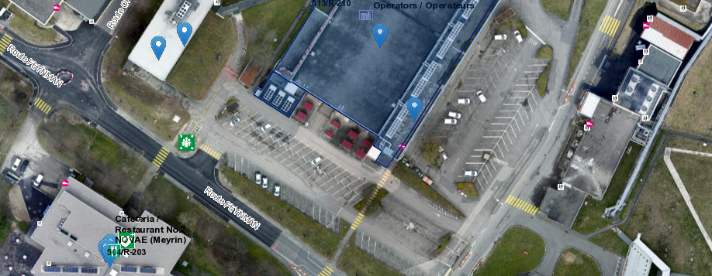
Data Centre Visits
Tent
Separate queues for DC, DCVP,
Web Film and IT Talks

Slide 9
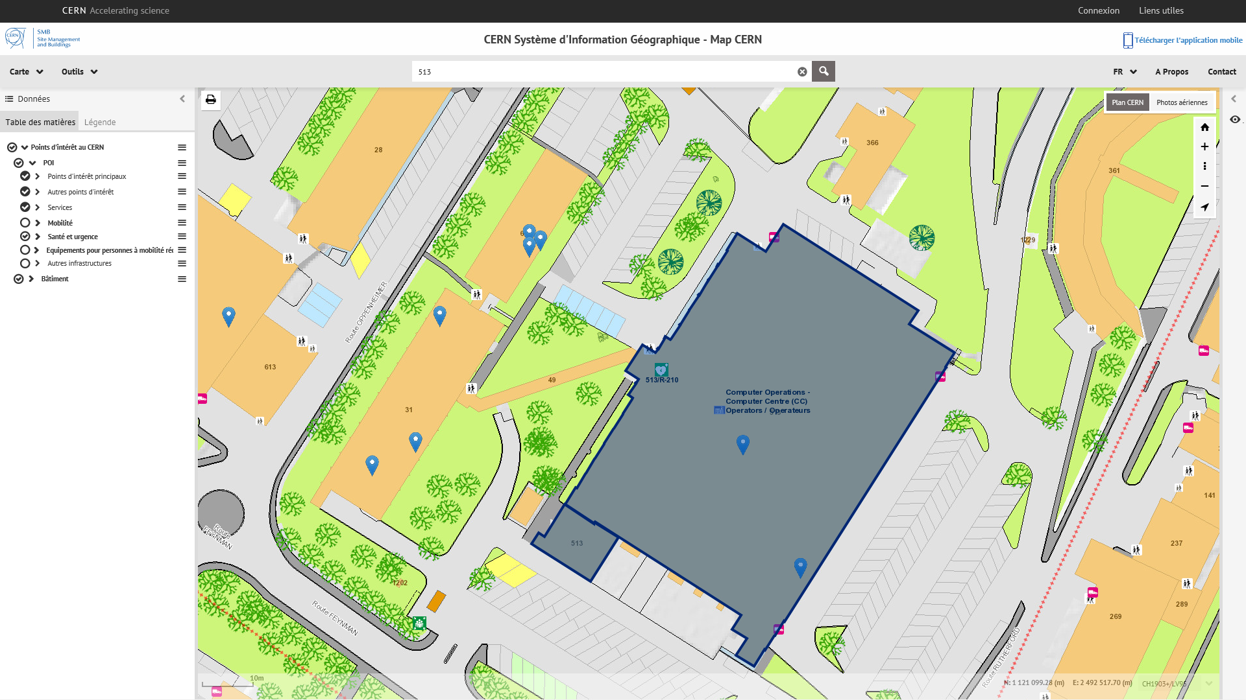

Data Centre Visits

Slide 10
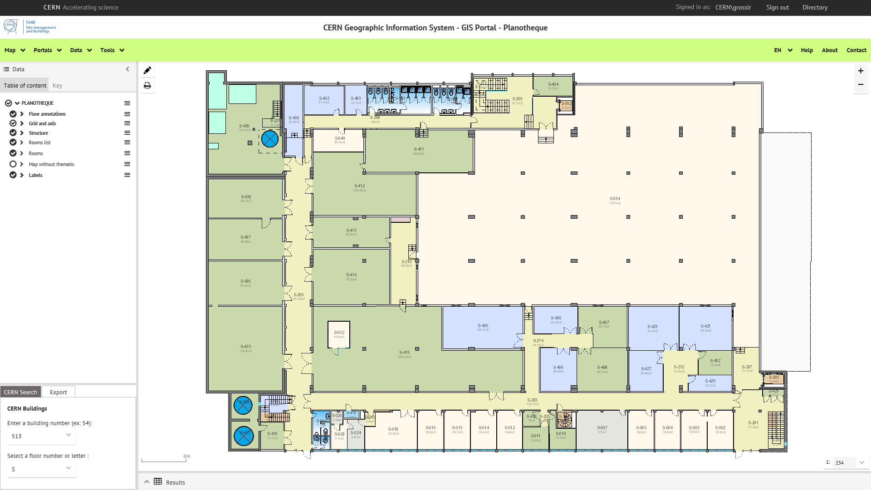
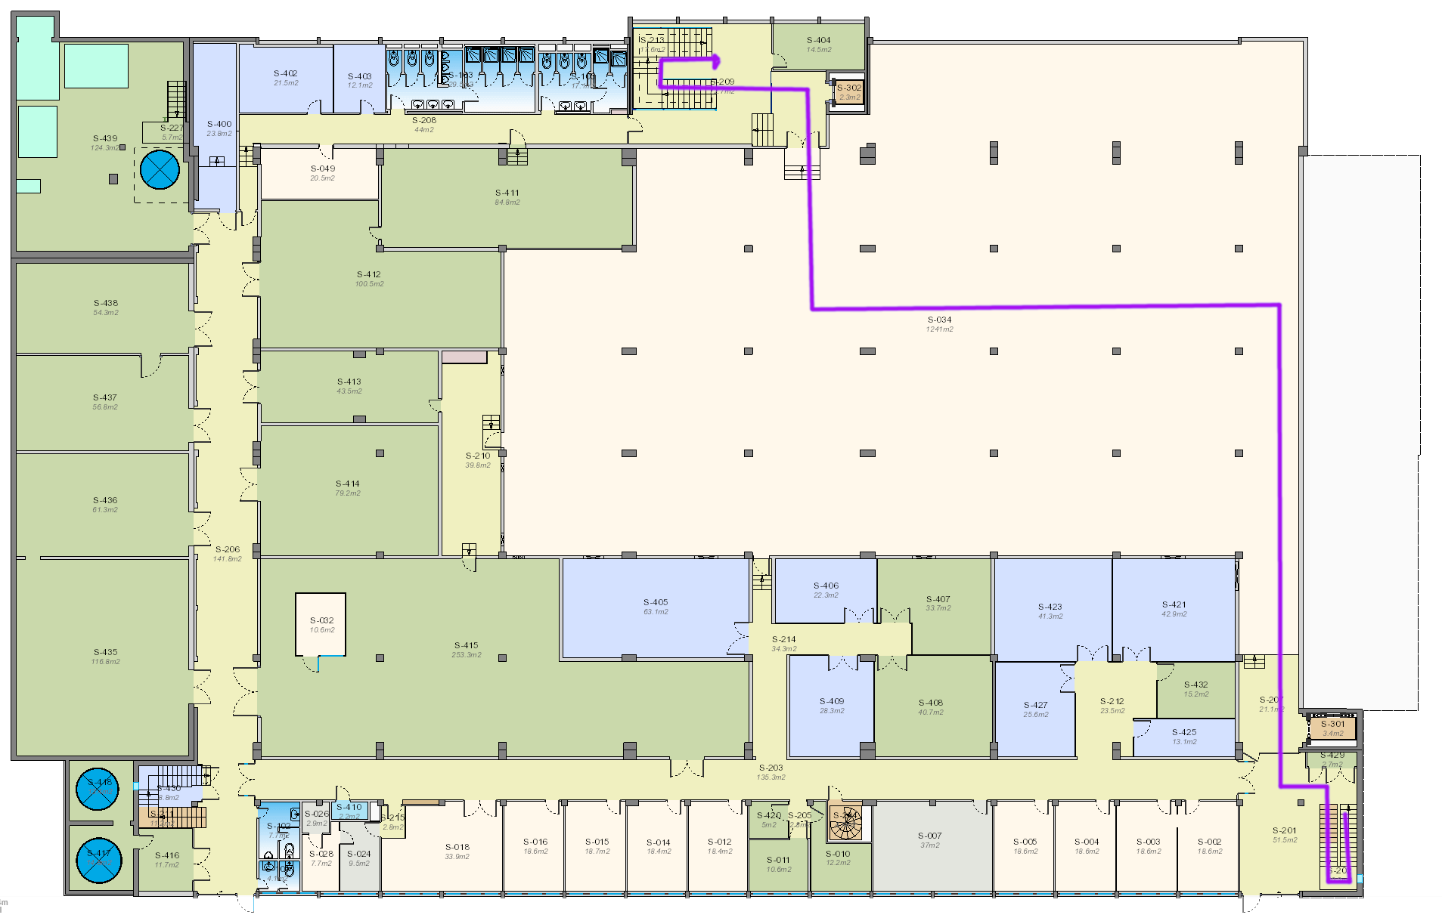
Data Centre Visits

Slide 11
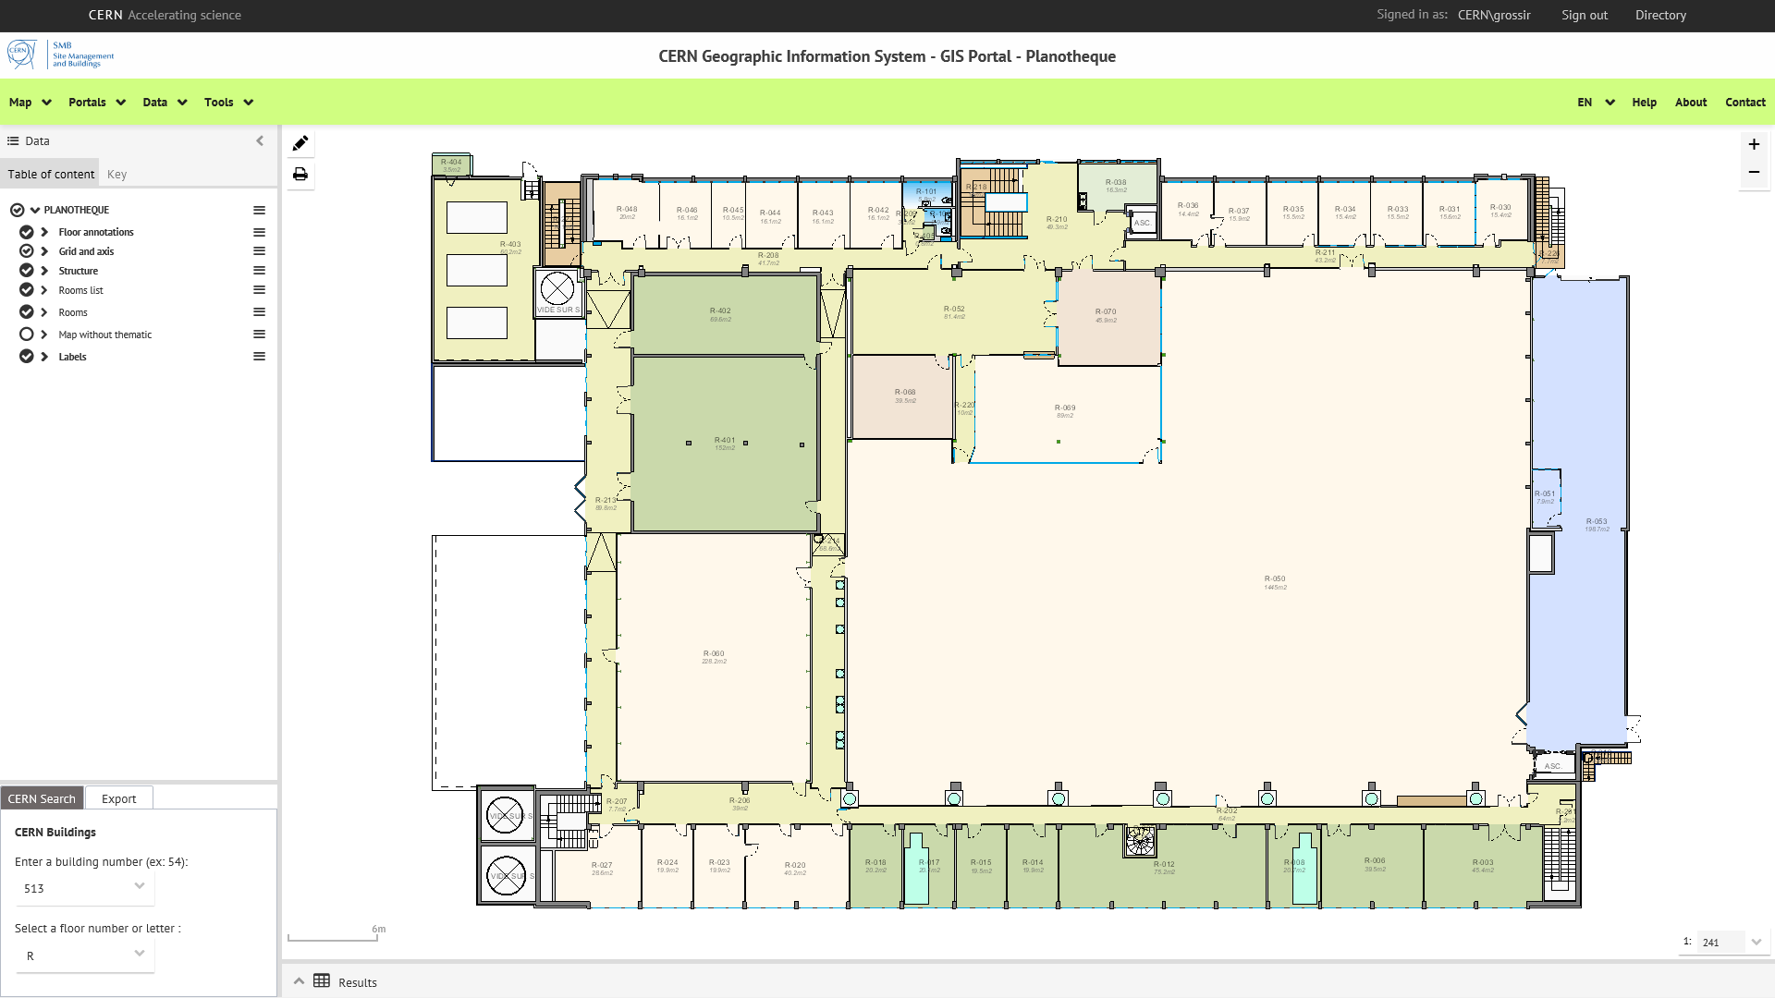
Data Centre Visits

Slide 12

Data Centre Visits - Disabled

Slide 13
Data Centre Visits - Presentation Main Points
Purpose:
  To provide most relevant information to visitors before starting their tour of the Data Centre
Where:
  In a tent on the B513 car park.
Content:
  A few slides on two screens; one in English and one in French
  This should be available shortly
  Visitors informed about safety aspects and to not ask questions during the tour but to wait until the end
Followed by a short Q+A session:
  Data Centre guides available for answering the questions.

Slide 14
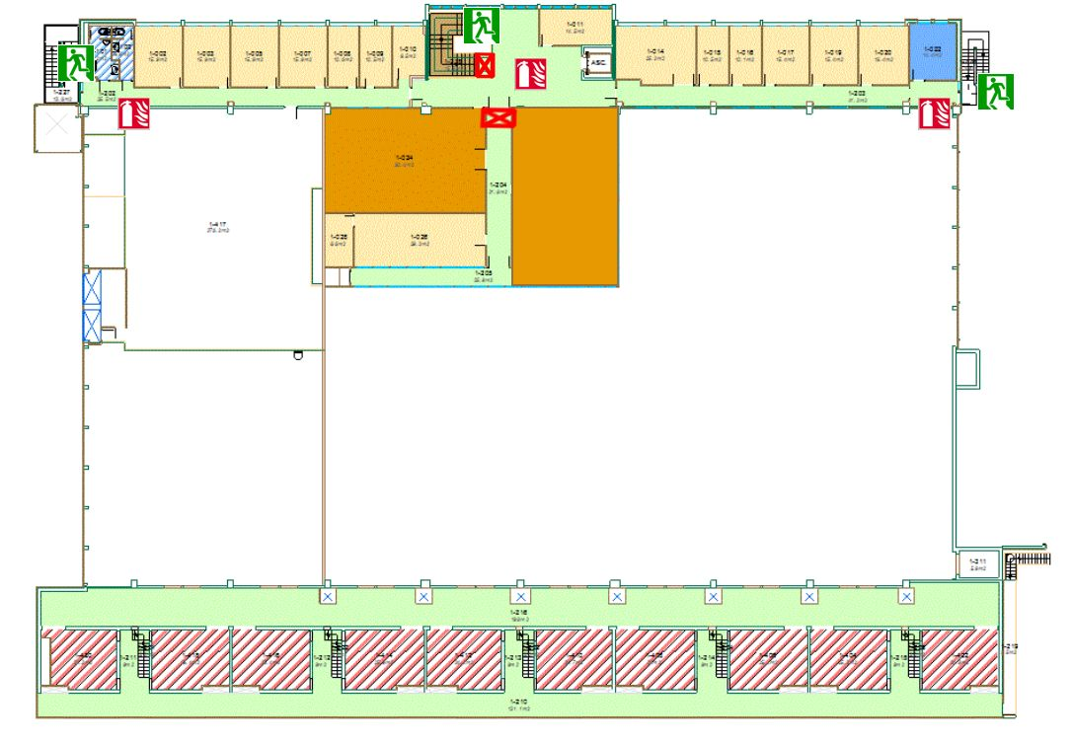

Data Centre Visit Point and IT Talks
DCVP
IT Talks

Slide 15
Overview of R2 Activities
Robotics and
Unplugged
Assembly Point
Colouring and
Virtual Reality Goggles
Notes:
Assembly point?

Slide 16
Web Film
In IT Auditorium
2 Guides per group
Use main stairwell
No access to corridors or toilets
In case of emergency, choose the emergency route appropriately

Slide 17
Overview of R2 Activities - Programming “Poppy Ergo” robots
30 minutes session for 2 children + 1 parent per robot
A fun, interactive way to discover computational thinking
    Learn to decompose a big problem into small, simple steps
    8+ year-old age range: Program visually with blocks (SCRATCH-style environment)
10 minutes introductory slideshow that can play on a screen in the waiting area:
  What is a robot?
  Usage of robots at CERN
  How Poppy Ergo is built on the same technologies used by CERN researchers (Python, GNU/Linux etc…)
There will be a certificate for those completing the activity.
There are dedicated training courses for the animators.

Slide 18
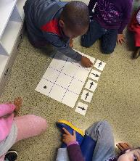
Overview of R2 Activities - Unplugged
How long: 30min
What: Introducing children to some basic programming concepts
How:
  Using just paper!
    Arrow cards
    Squared board
Requisites:
  Age: 6 to 8, older also possible but maybe too easy!
  Groups of 3 or 4
  Parents should stay and supervise
There will be a certificate for those completing the activity.
There are dedicated training courses for the animators.

Slide 19
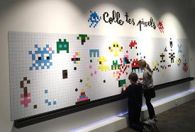
Overview of R2 Activities - Colouring corner
How long: No time limit
What: Space where children can colour
How:
  Special corner with small tables and colours
  Colouring book
  Pixel project
Requisites:
  Age: from 3 to 6 years old
  Parents should stay and supervise
  Robotics and Unplugged animators to supervise in off periods.
  There will be balloons available to give away. Help from the animators would be appreciated to help inflate them.

Slide 20
Overview of R2 Activities - Virtual reality goggles
5 Virtual reality goggles at a time
  Another 5 on-charge
Data Centre virtual visit
Volunteers to help setup the goggles
Robotics and Unplugged animators to supervise in off periods

Slide 21
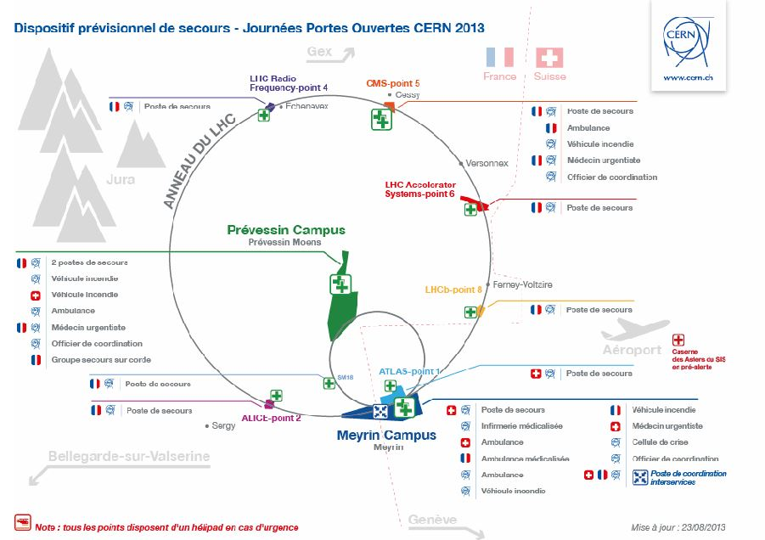


GENERAL SAFETY
Numbers to call
CERN FIRE BRIGADE 7 44 44
SERVICE DESK 7 77 77
IT Site Manager
Wayne Salter 16 42 24
R2 Activities Co-ordinator
Jaroslava Schovancova 16 83 01
IT Safety Co-ordinators
Anthony Grossir 16 35 38
Alain Gentit 16 86 17

Slide 22


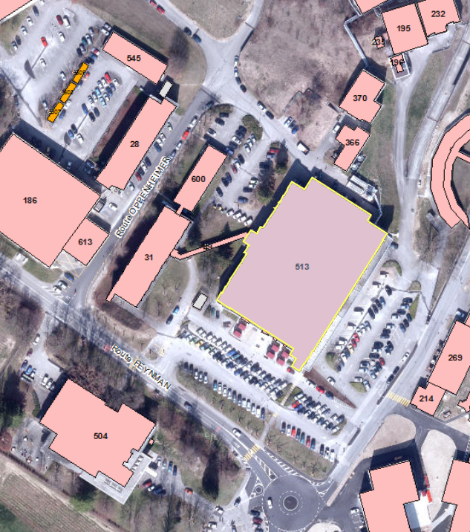


Fire extinguishers
CO2 for the Computer Centre
Water for the corridors, offices and the tents
Emergency exits
Fire alarm trigger
At each exit of the building
Assembly point

Slide 23

WHAT TO DO IF
There is a fire
Use extinguisher if appropriate
Evacuate & Press evacuation alarm
Go to assembly point
Call 74444 & Site Manager
The fire alarm rings
Evacuate with your group (don’t take lifts)
Go to the Assembly point
Report to fire brigade / site manager
There is an accident
Call 74444
Call site manager
Misbehaving persons
Stay calm
If applicable you can stop the visit
Call site manager
7 44 44
Anything putting people at risk should be
Immediately reported to the site manager

Slide 24


Electricity – low and high voltage
Electrical shock
Electrocution
Fire
Noise
No protection required in the Computer Centre for visitors
(but is provided on request and advisable for children)
Fall from a height
False floor
Stair balustrades
Narrow exits
Beware of this in the event of an evacuation
Slippery surface
Computer Centre floor tiles
Stairs
Emergency staircases

Slide 25

20 VISITORS = 2 GUIDES
KEEP AN EYE ON THE GROUP

Slide 26
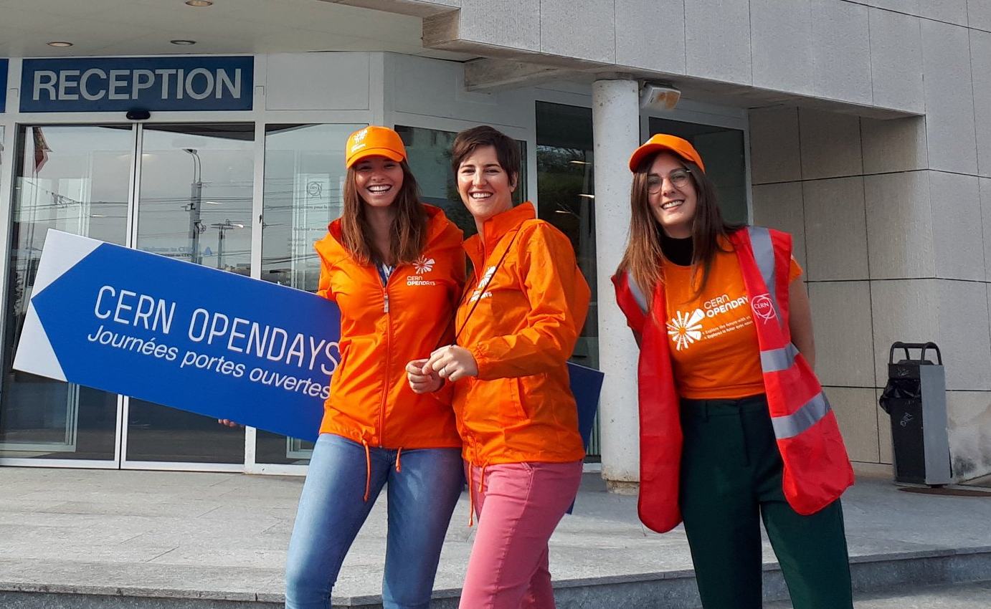
Follow Up
If you have any further questions then please feel free to contact me.

